Slide 1

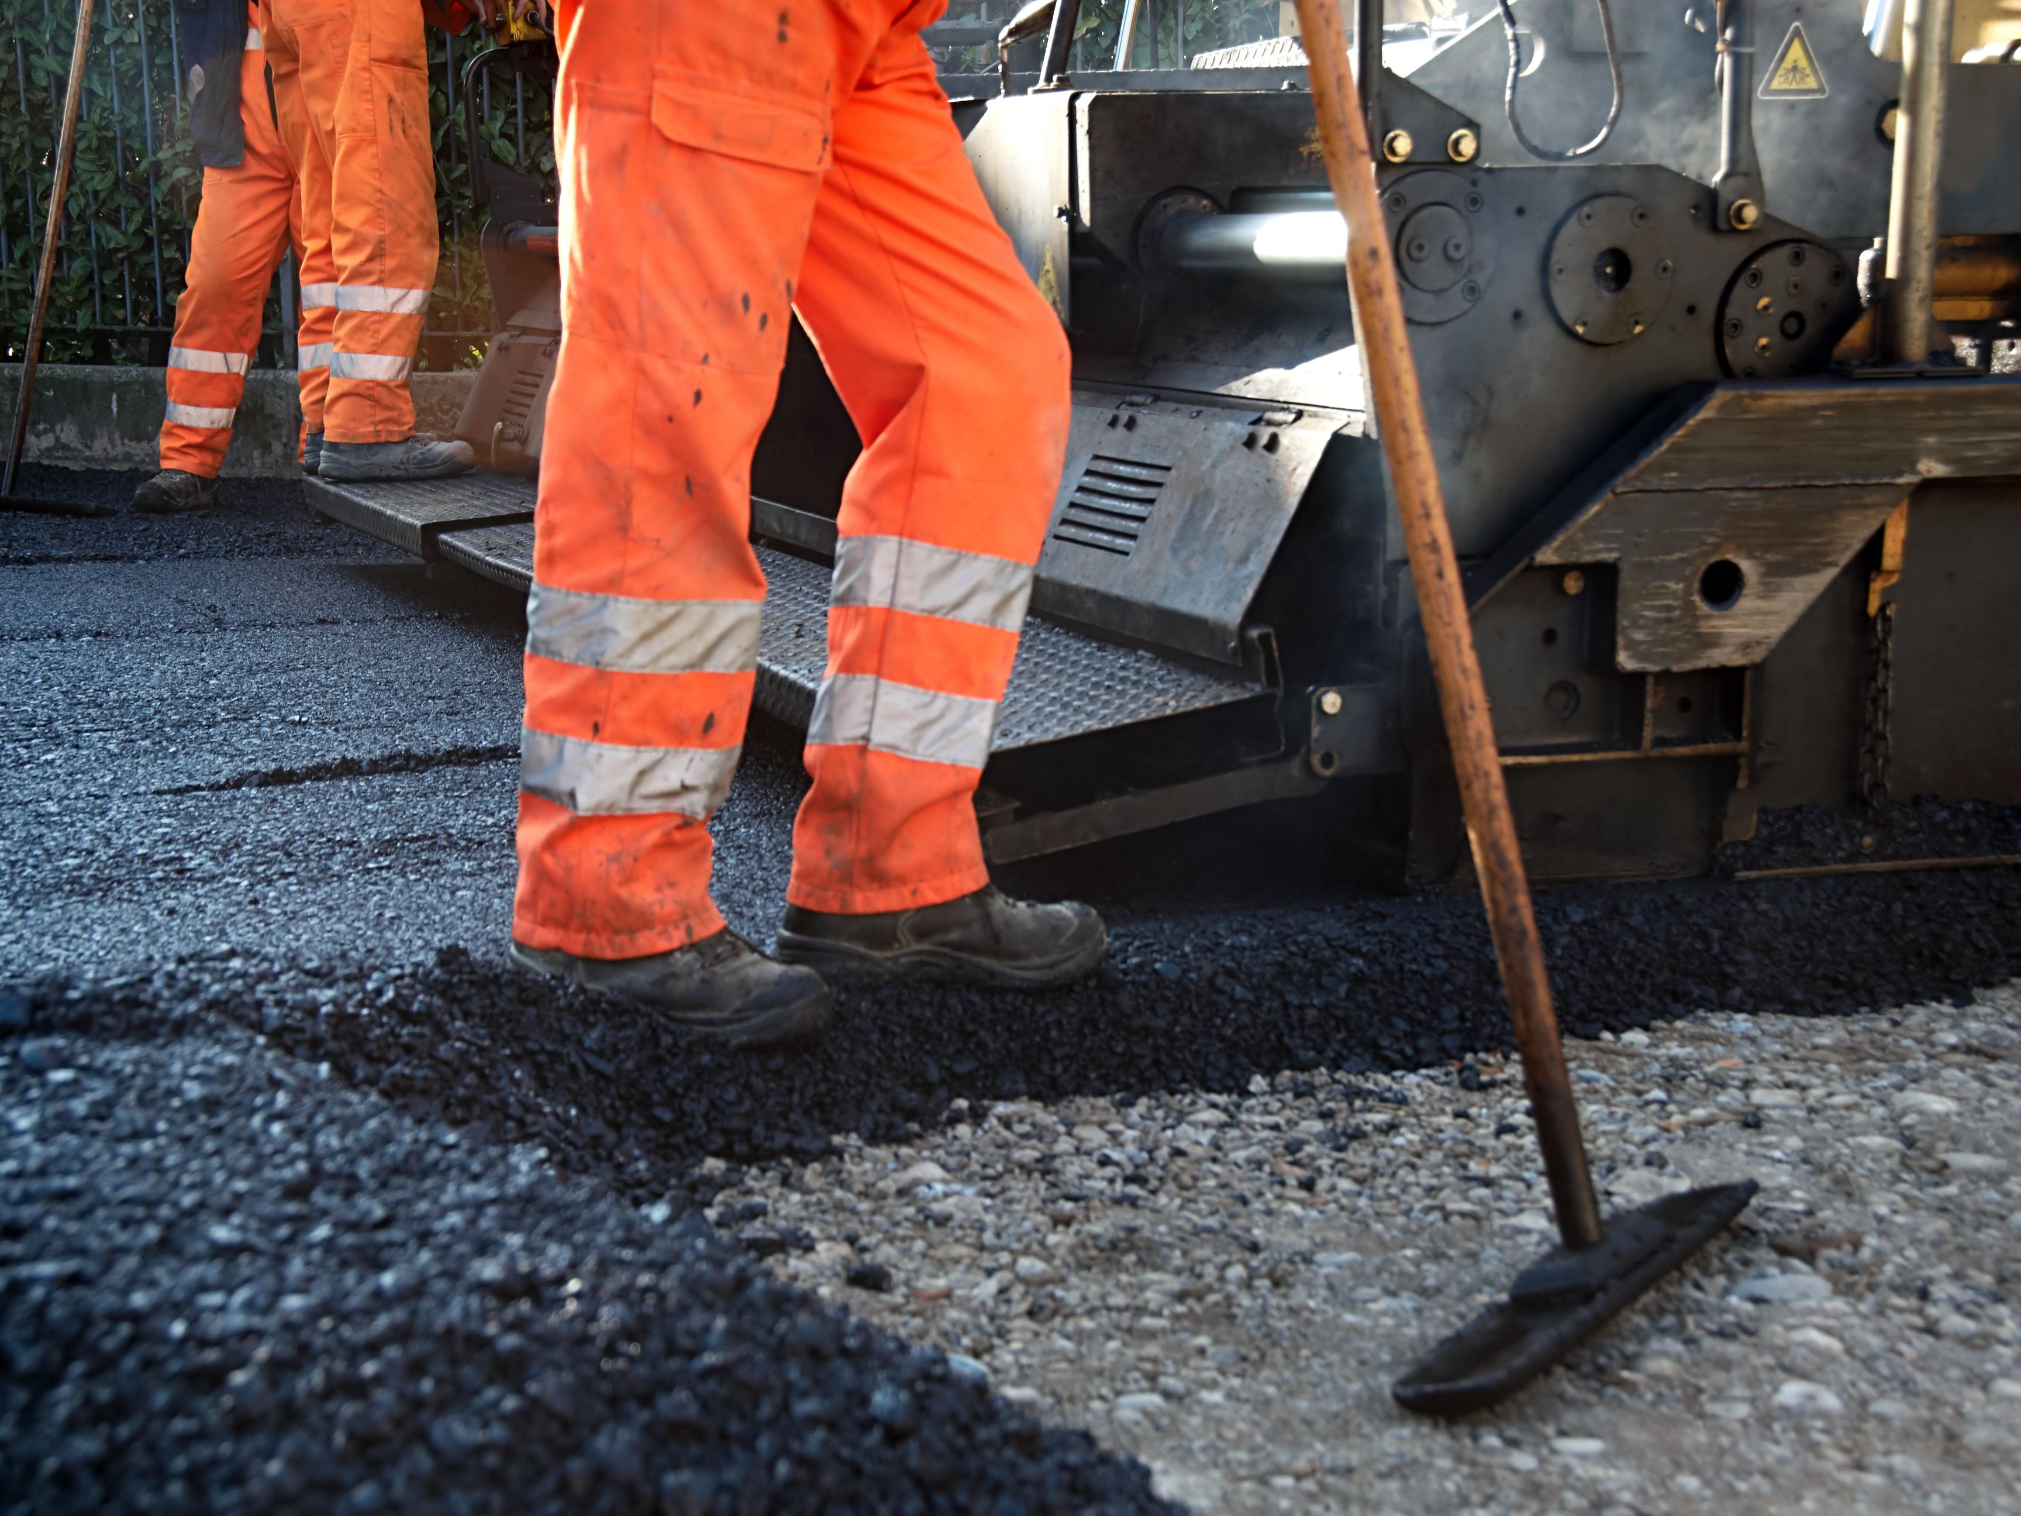


2015 – 2040
APAC WARM MIX ASPHALT ADDITIVES MARKET
FORECAST & OPPORTUNITIES
Prepared for :
MARKET INTELLIGENCE . CONSULTING
www.techsciresearch.com

Slide 2
Market Overview: APAC Warm Mix Asphalt Additives Market
APAC Warm Mix Asphalt Additives Market Size, By Volume, 2015, 2020, 2021E, and 2040F (Tonnes)
APAC Warm Mix Asphalt Additives Market Share, By Top 5 Company, By Volume, 2021E
APAC Warm Mix Asphalt Additives (WMA) market was valued at 53.8 thousand tonnes in 2020 and is estimated to grow at a CAGR of 8.72% till 2040 owing to increased spending on infrastructure and construction. The demand for Warm Mix Additives for Asphalt is expected to increase in the forecast years due to increasing demand for eco-friendly asphalt additives.
MeadWestvaco Asphalt Innovations and Sasol Wax are the top players followed by PQ Corporation and Kumho Petrochemicals. The market of Warm Mix Asphalt Additive is increasing in Asia Pacific countries due to rising awareness about the advantages of such additives.
APAC Warm Mix Asphalt Additives Market Share, By Application, By Volume, 2021E
APAC Warm Mix Asphalt Additives Market Share, By Country, By Volume, 2021E
Road Construction and Pavement applications are expected to remain dominant in APAC Region because they help in reducing the dependency of customers on adhesion promoters. The road construction and pavement segment dominates the market with the market share of 97.51% in 2020 and it is expected to increase to 97.97% in 2040. APAC Region is expected to surpass the demand for Warm Mix Asphalt Additives in the US due to rapid industrialization in developing countries.
China is expected to remain the dominant country in terms of volume for the demand of Warm Mix Asphalt Additives due to rising road construction activities. Moreover, with the rising population and per capita income, the demand for Warm Mix Asphalt Additives is expected to boost. The demand for WMA Additives in Asian Countries like Malaysia, Indonesia, Singapore, Japan, South Korea, Vietnam, Thailand and Australia is anticipated to rise, owing to growing need for roads and better infrastructure.
Source: TechSci Research

Slide 3

Recommendations for HPCL
The demand for Warm Mix Additives is expected to grow exponentially at a CAGR of 14.8% till 2040. Increasing concern for green house gases emission and future projection of sustainable infrastructure will pave the way for the growth of Warm Mix Additives market. It is expected that by 2040 India will have a potential of domestic production of 37 thousand tonnes by 2040.
Presently in India, there are no manufacturers of such additives that can decrease the production and workability temperature. HPCL will have the advantage of being the first domestic manufacturer of additives for the production of warm mix asphalt mixture. HPCL should also look forward to urging the contractors of government smart cities projects to use Warm Mix Asphalt Additives so as to improve workability and paving length and also reduce energy consumption.
Also, the Warm Mix Asphalt produced with additive technologies has grown significantly since 2011 in construction, giving a huge potential to additive market. It is recommended that HPCL should invest in setting up a production for Warm Mix Asphalt Additives till the forecast period.
Some of the major customers of Warm Mix Asphalt Additives are Nepal, Bangladesh, Australia, China, Malaysia, South Korea, Japan, Saudi Arabia, South Africa. European and American Market is flooded with numerous players that provide with either Organic, Chemical or Foaming based additives and they have an established market. APAC countries and MEA countries are still new to this product category and have enormous potential in the market for Warm Mix Asphalt Additives. HPCL can be one of the competitors to provide a new variety of additives for production of Warm Mix Asphalt Mixtures.

